Slide 1
Simon Says What
Company Name
Quarter
Date
Zaki Mir, Tru Nguyen, Ajay Doppalapudi, Bryan Perez

Slide 2
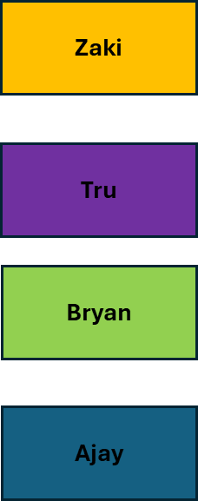
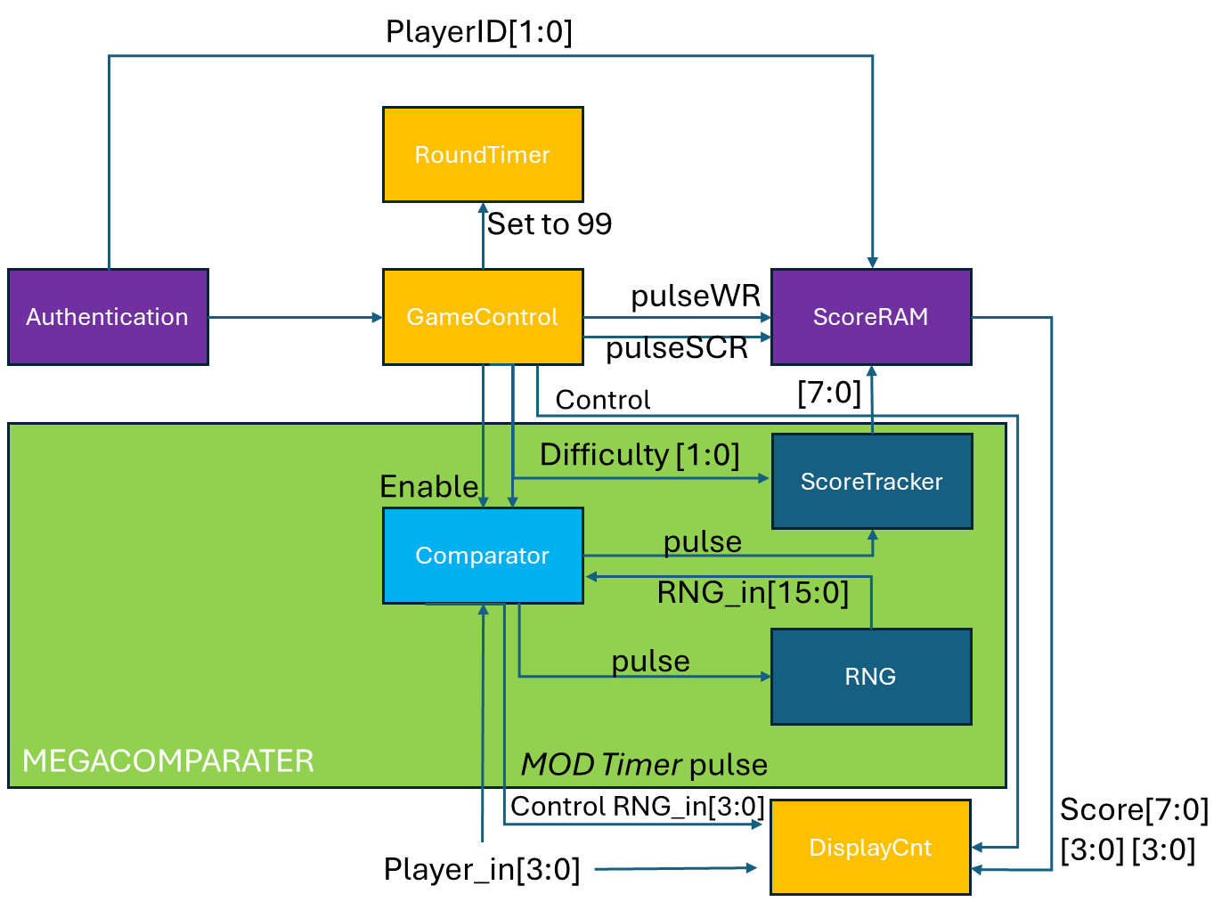
System Architecture

Slide 3
Comparator

Slide 4
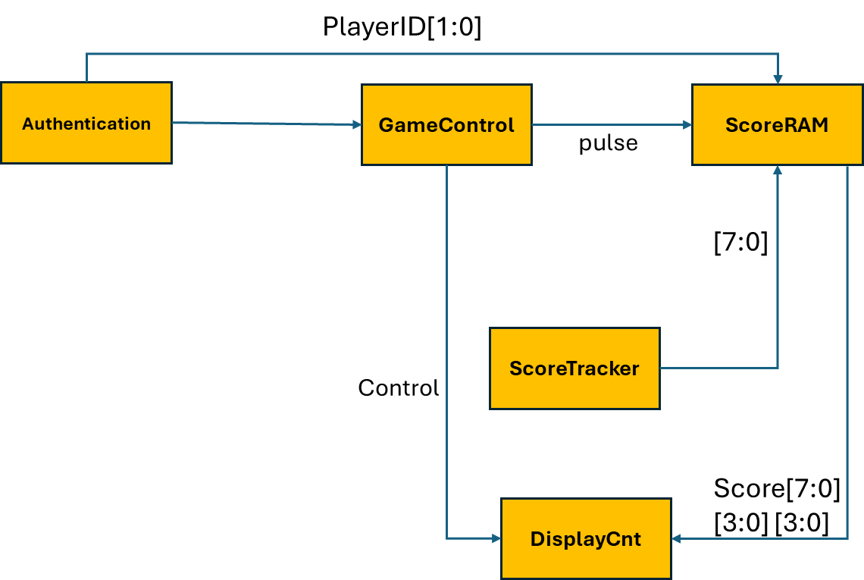
Game Controller

Slide 5
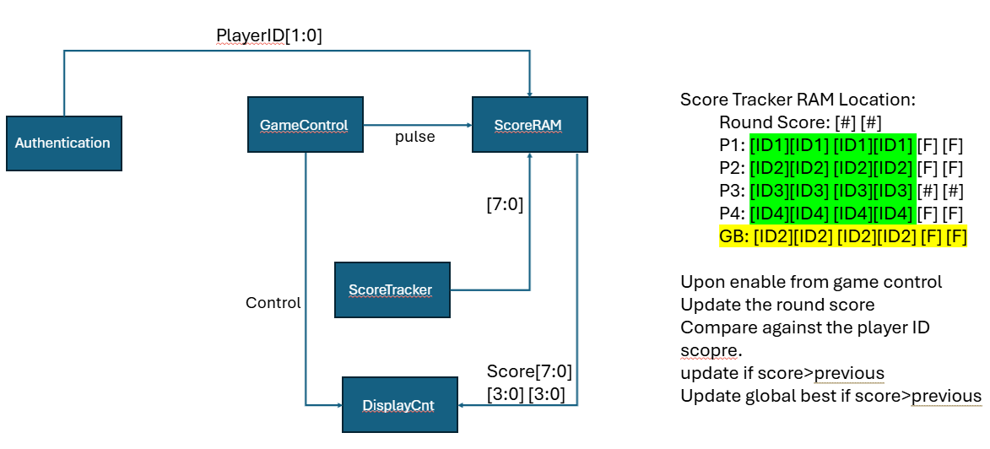
Authentication & scoreRAM

Slide 6
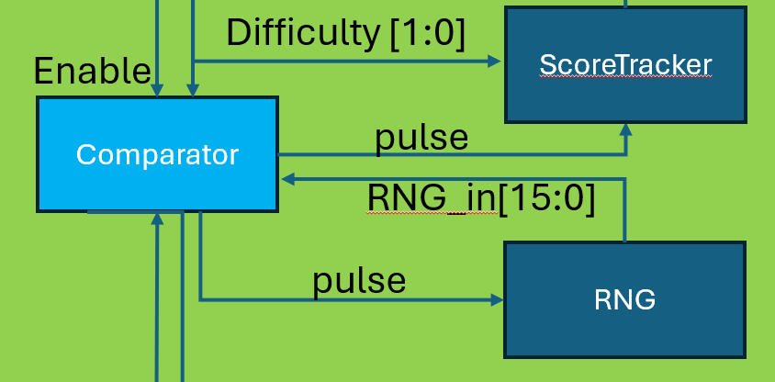
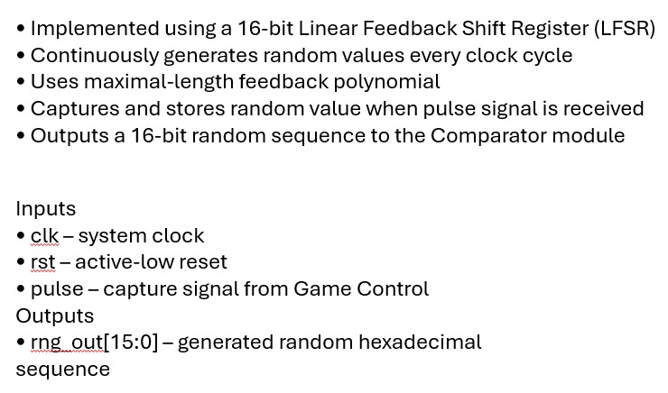
RNG
The RNG module is responsible for generating pseudo-random hexadecimal sequences used during gameplay. These random values create the memory pattern that the player must reproduce.

Slide 7
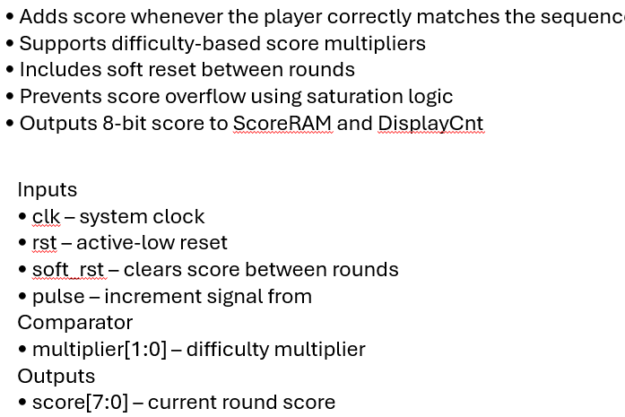
ScoreTracker
The Score Tracker module maintains the player’s running score during gameplay.
Whenever pulse becomes HIGH, the module increments the score. • The added value depends on the difficulty multiplier. • soft_rst clears the score at the beginning of a new round. • Score saturates at 255 to prevent overflow.

Slide 8
Thank you Dr. Chen!

